Slide 1
The Salvation of the Soul

Slide 2
1 Peter 3:1-7

Slide 3
Salvation of the Soul
1 PETER
What is the Salvation of the Soul?
The Salvation of the soul is the total transforming work of God upon our lives, which is presently being realized in the midst of Christ like suffering, and which in the future will be unveiled in Christ like glory.

Slide 4
Salvation of the Soul
1 PETER
What is the Salvation of the Soul?
“But may the God of all grace, who called us to His eternal glory by Christ Jesus [our future goal], after you have suffered a while, [our present reality] will make you perfect, establish, strengthen, and settle you [the salvation of the soul] ” (1 Peter 5:10)

Slide 5
Salvation of the Soul
1 PETER
Life Salvation - One Condition
Belief in Jesus, who Suffered for Us,
to Secure Eternal life.
Soul Salvatoin – Many Conditions for Many Rewards
Continual Trust in Jesus, to Suffered with Him, to Secure an Abundant Eternal Life,.

Slide 6
Salvation of the Soul
1 PETER
Our Present Suffering Life
Many Requirements
Our Future Abundant Life
Many Rewards
Obedience and Fear toward God
The End of Faith
Love and Collective Growth toward the Brethren
Incorruptible and Undefiled Inheritance that Never Fades
Denial of lusts, Honrable Conduct and Subjection toward the World
Commendation and Credit before God.
Suffering for Doing Good and Service to God
Approval, Blessings, Exaltation
Praise, Honor and Glory; Crowns

Slide 7
Salvation of the Soul
1 PETER
Current Experience
Future Experience
“born again”
“to an inheritance”
“grieved by various trails”
“to praise, honor, and praise”
“not seeing, yet believing, rejoicing with joy”
“the end of your faith,
salvation of your soul”
“the sufferings of Christ”
“the glories that follow”
“spoken as evildoers for honorable conduct”
“given glory to God by your good works ”

Slide 8
Salvation of the Soul
1 PETER
Current Experience
Future Experience
“submission with fear, enduring grief, suffering wrongfully”
“Commendation and credit before God”
“sufferings for righteousness
“you are blessed”
“fiery trail and partaking in Christ’s suffering”
“when His glory in revealed, gladness with exceeding joy”
“men serving and submitting”
“a crown of glory, exaltation”
“suffer for awhile”
“eternal glory, perfection…”

Slide 9
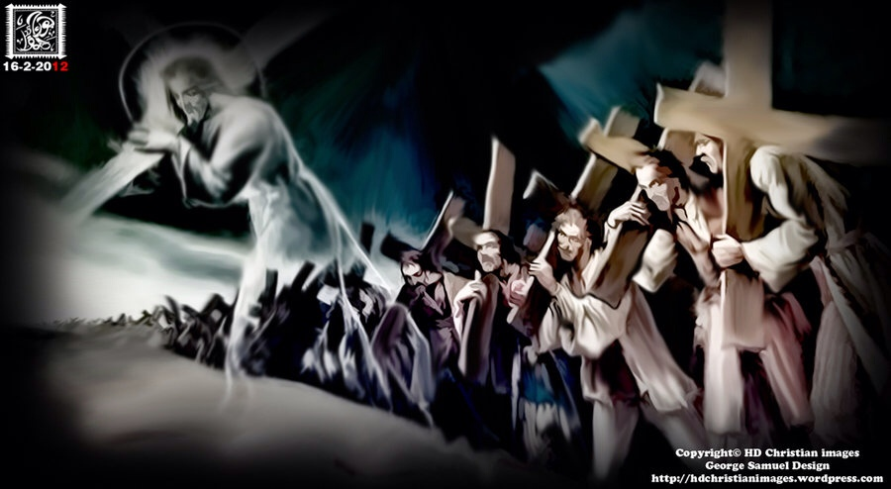
Salvation of the Soul
1 PETER
We are called to patiently endure unjust suffering just as Christ showed us the way to suffer.
Notes:
He not only is the way, the truth and the life, but also shows us the way to suffer, to die, to live. We follow Him in the way to suffer and in the way of submission. Christ’s sufferings are the model on how to respond to injustice, for He experienced the greatest injustice of all. So we too are told to take up your suffering and follow Him in His footsteps.

Slide 10
Salvation of the Soul
1 PETER
Outline

Slide 11
Salvation of the Soul
1 PETER
Body: Salvation of the Soul, Worked out in Experience – 1:13 – 4:19
In Relation:
to God – 1:13-21
to Brethren – 1:22 – 2:10
to the World – 2:11 – 3:7
to Life Itself – 3:8 – 4:6
to the Consummation of History – 4:7-19

Slide 12
Salvation of the Soul
1 PETER
Body: Salvation of the Soul, Worked out in Experience – 1:13 – 4:19
In Relation:
to the World – 2:11 – 3:7
through Abstinence from the Lust of the Flesh – 2:11
through Honorable Conduct – 2:12

Slide 13
Salvation of the Soul
1 PETER
Soul Salvation:
When a believer abstains from a sensual worldly life and lives honorably he experiences the salvation of the soul consisting in deliverance from suffering, grief, defeat and the loss of temporal and eternal blessing for the ultimate glory of God.
Notes:
A believer who saves his soul by postponing personal gratification now knows that in the end it is not really lose proposition, because he knows what David said in Psalm 16:11, “In the Lord’s presence is fullness of joy; At Your right hand are pleasures forevermore.”

Slide 14
Salvation of the Soul
1 PETER
Body: Salvation of the Soul, Worked out in Experience – 1:13 – 4:19
In Relation:
to the World – 2:11 – 3:7
through Subjection – 2:13 – 3:7
Subjects to Civil Authorities – 2:13-17
Slaves to Masters – 2:18-25
Wives to Husbands – 3:1-7
Notes:
There are three natural divisions: first is general submission to every human institution (2:13-17); second, specific submission of slaves to masters (2:18-25); and third specific submission of wives to husbands (3:1-7). These basic social relationships are the result of believers being in the world, but we are not to be of the world. Our conduct is to set apart from the world in which we live.
Peter has in mind primarily our dealings with the unsaved (saved slaves with unsaved masters or saved wives with unsaved husbands).
“Three areas of subjection are covered by Peter. He writes about submission in public affairs, professional affairs and private affairs. Subjection is to permeate public life, the home (house slaves) and the family. Each area becomes more personal and is a deeper more difficult subjection. Peter sets up the model of Christian subjection beginning from the outward and most visible to the inward and most private.” (Hodges, p. 50)
Now is the only time that we can learn what it means to be in submission, since during the Kingdom we will not be submitting, but ruling with Christ. We who have learned submission and suffered with Christ will rule with Christ, we will have saved our soul, that is, our inheritance. By believing we enter the Kingdom and by suffering we inherit the Kingdom. Blessed are the poor, for they shall inherit the kingdom.

Slide 15
Salvation of the Soul
1 PETER
Body: Salvation of the Soul, Worked out in Experience – 1:13 – 4:19
through Subjection – 2:13 – 3:7
of Wives to Husbands – 3:1-7
with Fear – 3:1-2
with a Gentle and Quiet Spirit – 3:3-4
with Sarah as an Example - 3:5-6
Notes:
Peter extends the principles of respect and submission to authority from Christian conduct in the world to conduct in the family. The salvation of the soul consists of a behavior of wives submitting to their own husband and husbands being considerate of their wives.

Slide 16
Salvation of the Soul
1 PETER
In Relation to the World - 1:22 – 3:7
Through Subjection of Wives to Husbands – 3:1-7
“Wives, likewise, be submissive to your own husbands, that even if some do not obey the word, they, without a word, may be won by the conduct of their wives, when they observe your chaste conduct accompanied by fear.” (3:1-2)
Notes:
Women be submissive…” I’ll never forget the time the Pastor’s wife, of the First Baptist Church of Plantation said, “Genesis creation story was written by male chauvinist rabbis to explain why women should be submissive to men. I thought to myself, “How could this be true?”, if you say you believe in the Bible. Now I don’t believe that at all, that it was just made up.
First of all, we are all called to submit, no one is exempt. Paul says in Ephesians 5:21 we are to “submit one another in the fear of God.” (Eph. 5:21)
Wives are called to submit to their husband “likewise”, just as, subjects are to submit to civil authorities, and house slaves/employees are to submit to their masters. Being submissive is to place or arrange oneself in an orderly manner. The specific situation that Peter mentions is a believing wife married to an unbelieving husband, though the principles apply to any married relationship.
If some husband does not believe/obey the word “logo” (the gospel) the submissive conduct of the wife will win or gain their husband without a word “logou”. “The Christian wife will have generally a better opportunity to win her husband if she minimizes the witness of her words and maximizes the witness of her ways” (Hodges, p. 56)
Unbelievers are observing or watching us. An unbelieving husband is watching a believing wife’s pure or holy conduct and submissive spirit.

Slide 17
Salvation of the Soul
1 PETER
In Relation to the World - 1:22 – 3:7
“For though I be free from all men, yet have I made myself servant unto all, that I might gain the more. And unto the Jews I became as a Jew, that I might gain the Jews; to them that are under the law, as under the law, that I might gain them that are under the law…
Notes:
1 Cor. 9:19-21
For though I be free from all men, yet have I made myself servant unto all, that I might gain the more. And unto the Jews I became as a Jew, that I might gain the Jews; to them that are under the law, as under the law, that I might gain them that are under the law; To them that are without law, as without law, (being not without law to God, but under the law to Christ,) that I might gain them that are without law [KJV]

Slide 18
Salvation of the Soul
1 PETER
In Relation to the World - 1:22 – 3:7
“To them that are without law, as without law, (being not without law to God, but under the law to Christ,) that I might gain them that are without law.” (1 Cor. 9:19-21) [KJV]

Slide 19
Salvation of the Soul
1 PETER
In Relation to the World - 1:22 – 3:7
Through Subjection of Wives to Husbands – 3:1-7
“Do not let your adornment be merely outward — arranging the hair, wearing gold, or putting on fine apparel — rather let it be the hidden person of the heart, with the incorruptible beauty of a gentle and quiet spirit, which is very precious in the sight of God.“ (3:3-4)
Notes:
These verses do not forbid the adornment of the outward appearance, but they warn against a preoccupation with such adornment. Peter’s point is that women should let their true adornment be inward and spiritual. Women as well as men should be preoccupied with an inward development and the renewing of the mind.
“For bodily exercise profits a little, but godliness is profitable for all things, having promise of the life that now is and of that which is to come.” (1 Tim. 4:8)
Man looks on the outside, God looks to the inside. What God discovers is very valuable to Him. A gentle and quite spirit is prized more to God than costly clothing and gold jewelry. Women should not think that outer attire is the source of real beauty.
Remember what Jesus said about the gentle? "Blessed are the gentle, for they shall inherit the earth.” (Matt. 5:5) [NASU]

Slide 20
Salvation of the Soul
1 PETER
In Relation to the World - 1:22 – 3:7
Through Subjection of Wives to Husbands – 3:1-7
“For in this manner, in former times, the holy women who trusted in God also adorned themselves, being submissive to their own husbands, as Sarah obeyed Abraham, calling him lord, whose daughters you are if you do good and are not afraid with any terror.” (3:5-6)
Notes:
Peter mentions there were many wives in the past who exhibited this spirit of submission, giving Sarah as a specific example. She called him lord, a term of respect and obedience. Sarah recognized Abraham as the leader and head of the household. First of all, Sarah put her hope in God.
There were three times in recorded Scripture Abraham told Sarah to do something. Once she fixed a meal for God and His two accompanying angels (Gen. 18). Twice she was told to lie about being Abraham’s wife and had to trust God to rescue her from two king’s harams. It was Abraham who did not trust God, but feared for his life, on this occasion.
Wives today do good and become a daughter of Sarah reflecting her character, following her example, trusting God and not giving in to fear.

Slide 21
Salvation of the Soul
1 PETER
Body: Salvation of the Soul, Worked out in Experience – 1:13 – 4:19
through Subjection – 2:13 – 3:7
of Husbands to Wives – 3:1-7
with Understanding – 3:7a
with Honor – 3:7b
as a Weaker Vessel and Co-heirs - 3:7c

Slide 22
Salvation of the Soul
1 PETER
In Relation to the World - 1:22 – 3:7
Through Subjection of Husbands to Wives – 3:1-7
“Husbands, likewise, dwell with them with understanding, giving honor to the wife, as to the weaker vessel, and as being heirs together of the grace of life, that your prayers may not be hindered.” (3:7)
Notes:
The church is to subject to Christ and Paul says husbands are to love their wives. Here Peter, (who was married by the way, Paul was not) does not continue the theme of subjection. Yet this is the logical place to give admonition to the husbands. This is almost like a footnote. Husbands are to give honor to their wives in like manner that they would give honor to the king. Give honor to whom honor is due.
Peter mentions that wives who are women are weaker vessels, but in what way? Have you noticed that men and women are different? Illustration -- Time Magazine – “News Flash, Men and woman are different.” Men and women are different physiologically, they are built differently. Men are stronger especially in the upper body. Whereas women are stronger in the pelvis area, the hips, for the purpose of caring a baby.
Differences, even weaknesses does not equate inferiority.
Husbands are to dwell with them with understanding as they are the weaker vessel, and to give honor to them as being heirs together of the grace of life. Male and female are mutual and necessary sharers of the grace or the gift of sharing in joint heirship, joint rulership. As trusting partners husband and wives stand before God as equal participates in the eternal inheritance God is reserving in heaven. Though at this time our rulership has been disrupted by the fall and sin. Satan currently rules, though restrained by the Spirit who dwells in Christ’s Church.
Husbands who fail to understand and honor their wives will have their prayer and request hindered, literally cut down or short. It is as if God suddenly becomes hard of hearing.

Slide 23
Salvation of the Soul
1 PETER
Conclusion
Notes:
As Believers in Christ we save our souls when we submit to civil authorities delegated by God, even when they may mock or punish us for doing good. We are to pay our taxes, even when they waste our tax dollars. We save our souls when as house servants we submit to our masters of the household, even to the means one. Wives save their souls when they submit to their own husbands, even when their wrong. And husbands save their souls when they dwell with their wives with understand and giving them honor, even when they are acting merely emotional and irrational. This is the salvation of the soul.
We save our souls when we continue to trust in Jesus, even when we suffer and are grieved by various trial, even when we suffer for doing good. We follow in His footsteps. This is the salvation of the soul.

